Slide 1
Introduction to CREATION PLATFORM
Next Generation
Digital Content Creation Tools

Slide 2
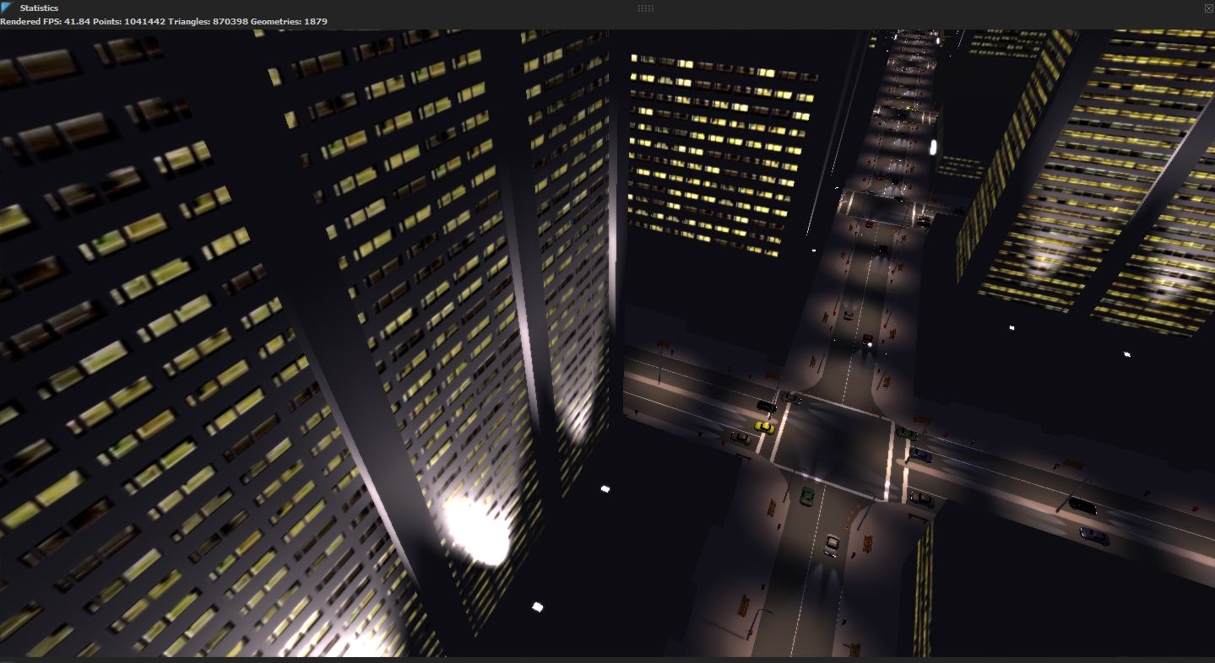
Demo Reel

Slide 3
State of today’s tools
Most DCCs are out of step with modern production
Opaque black boxes
Acting as a shell to custom tools
Monolithic
Don’t fully support modern hardware advances
Multicore CPUs
GPGPU Programming
Cloud Computing

Slide 4
State of today’s tools
Building from scratch sucks
TDs aren’t C++ experts, yet need to write tools
Your C++ experts have a lot to do already
Frameworks are complex beasts
It’s not your core business!

Slide 5
What’s needed?
A framework that fully utilizes modern hardware architectures….
…but is accessible to a regular TD…
…make it open & extensible…
…MAKE IT WORK WITH OUR PIPELINE!

Slide 6

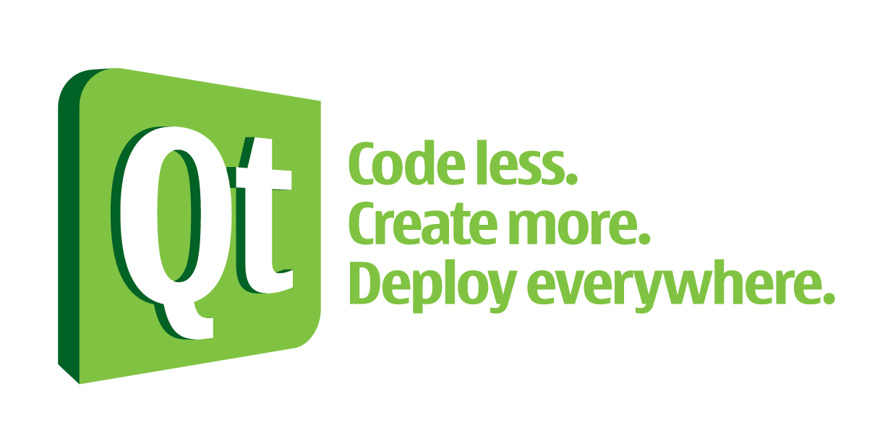


Architecture
KL (Kernel Language)
LLVM

Slide 7
What is it?
Creation Core
KL Compiler
Python Module
CP API
GPU Execution
CPU Multi-threading

Slide 8
Extensions
Alembic
FBX
Vicon
Lidar
….
KL Compiler
Python Module
CP API
GPU Execution
CPU Multi-threading

Slide 9
Application Services
Undo/Redo
Scene Graph
Curve Editor
Timeline
Geometry
Real-time Rendering
Debuggers
Manipulation
….
Alembic
FBX
Vicon
Lidar
….
KL Compiler
Python Module
CP API
GPU Execution
CPU Multi-threading

Slide 10
Creation Applications
Character Solvers
Muscle Simulation
Hair & Fur
Animation tool
….
Undo/Redo
Scene Graph
Curve Editor
Timeline
Geometry
Real-time Rendering
Debuggers
Manipulation
….
Alembic
FBX
Vicon
Lidar
….
KL Compiler
Python Module
CP API
GPU Execution
CPU Multi-threading

Slide 11
Example Application
Animation Tool
Undo/Redo
Scene Graph
Curve Editor
Timeline
Real-time Rendering
Alembic
FBX
KL Compiler
Python Module
CP API
CPU Multi-threading

Slide 12
Packaging Applications
Undo/Redo
Scene Graph
Curve Editor
Timeline
Real-time Rendering
FBX
Alembic
CP API
Creation Application
KL Compiler
Python Module
CPU Multi-threading
Animation Tool

Slide 13
Standalone vs Integrated
Python/Qt standalone application
Maya/Softimage/Nuke etc etc
Creation Application
Creation Application

Slide 14
What can I do with it?
Motion Capture Retargeting
Rigging & Animation
Virtual Production
Previs
Muscle Simulation
Hair & Fur Simulation
Procedural Vegetation
Asset Reviewing
Lighting setup
…
Run it standalone
Run it inside Softimage
Run it inside Maya
Run it inside any C++ app
Run it on a web server

Slide 15
Questions? First round of beers?

